Slide 1
S-100 Interoperability Catalogue
Original: Edward Kuwalek, IIC
Updated for NIPWG4
JP/RMM/EM
May 22nd , 2017

Slide 2


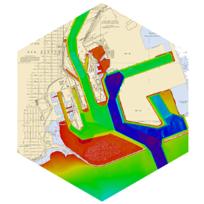
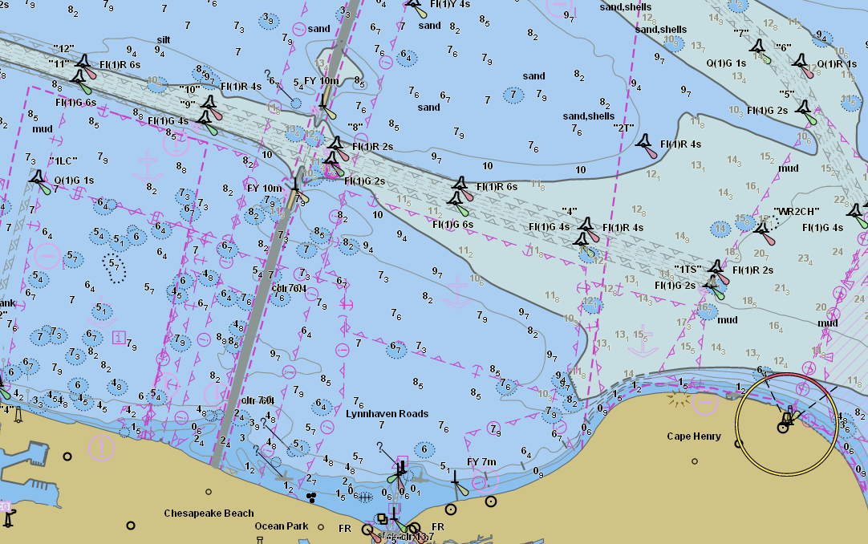
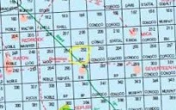

BAD Interoperability
Ship
Management

Slide 3
Objectives
Phase 1 - Interoperability Analysis
Draft - Mar/2016 and Final Report – May/2016
Phase 2 – Interoperability Catalogue Design
Interoperability Design Document
UML models + XML schemas + extras
Jul/2016
Phase 3 – Interoperability Catalogue Authoring
Draft Interoperability Catalogue (IC) XML
Sep/2016 – Mar/2017

Slide 4
Interoperability Analysis – Requirements
Long and diverse list of requirements ~70
Provide support for complex data loading scenarios
Data Interleaving
Partial Data Suppression
Partial Data Replacements
Data Replacement
Data Overlays
Facilitate easy loading of predefined product combinations

Slide 5
Interoperability Analysis - Requirements
Address Potential Data Clashes
Duplicate Feature Instances
Duplicate Feature Domains
Combined Geometry
Spatial Discrepancies
Facilitate Skin-Of-The Earth Feature Replacement
Provide support for comprehensive hierarchy of data and display priorities

Slide 6
Interoperability Analysis - Requirements
Support Harmonized Portrayal
Display of Significant Features
Avoid Obscuring Data
Colour Set-Asides
Day / Night / Dusk Modes
Portrayal of Data Quality for Combinations of Information Layers
Display of Text

Slide 7
Interoperability Catalogue Design
Change of paradigm – ENC is now part of larger data ecosystem
Modular, machine readable design leveraging existing designs for FC, PC, and geospatial rules
Fully user-controlled via system settings
Compatible with existing portrayal engine
Supporting different levels of interoperation
Additional customization by OEMs or users possible

Slide 8
Interoperability Catalogue Design - Levels
Level 0 – No explicit interoperability and IC is not used; ENC is the main product; all other data is loaded as overlays – effectively current ECDIS
Level 1 – Data interleaving; ENC is the main product but feature layers from other products are interleaved with ENC feature layers
Level 2 - Type-based selective feature class replacement is supported - ENC is the main product but global suppression of equivalent ENC features is allowed in favor of data layers from superior data products

Slide 9
Interoperability Catalogue Design - Levels
Level 3 - Attribute value-based selectivity and feature hybridization; ENC is treated as one of the components of the data stack, and selected feature instances from other products may be treated as being superior to or enhancing selected ENC feature instances
Level 4 - Spatial operations; This level is the same as Level 3, but permits spatial queries (to determine related subsets) and operations (to define the interoperation result) to determine replacements for selected feature instances; rules are explicitly defined using an adequate set of spatially-capable ‘grammar’

Slide 10
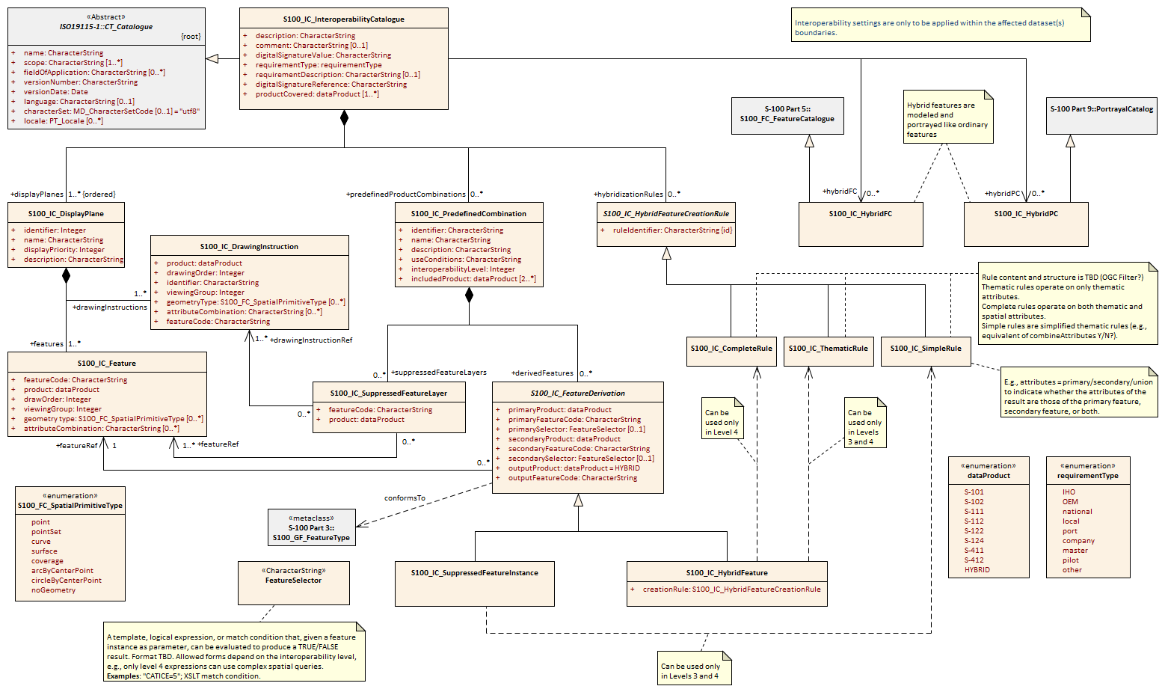
Interoperability Catalogue model

Slide 11
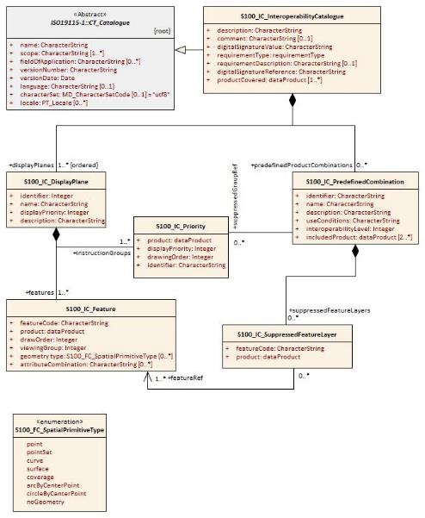
Interoperability Catalogue Level 1 & 2
Levels 3 and 4 on hold

Slide 12
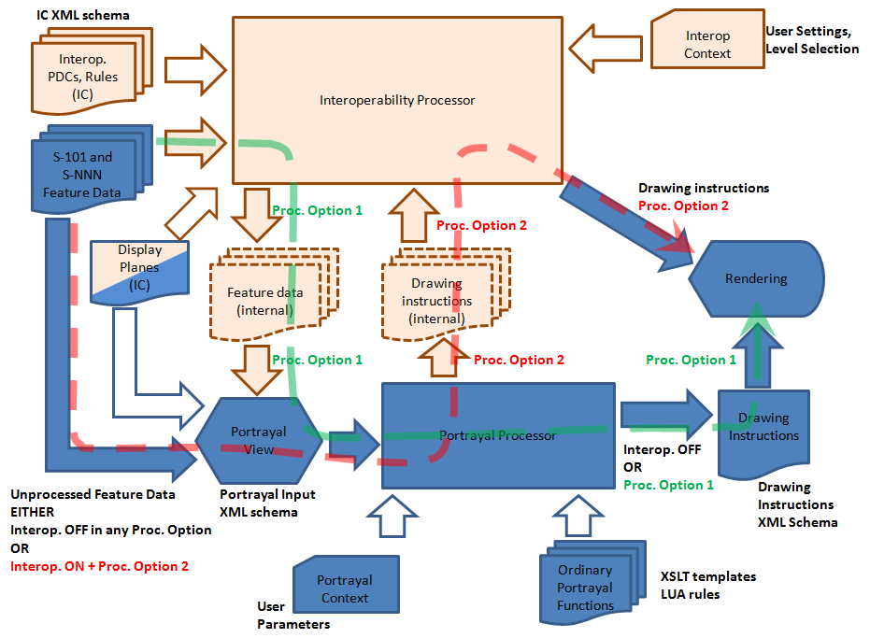
Overview of feature processing paths
Levels 3 and 4 on hold

Slide 13
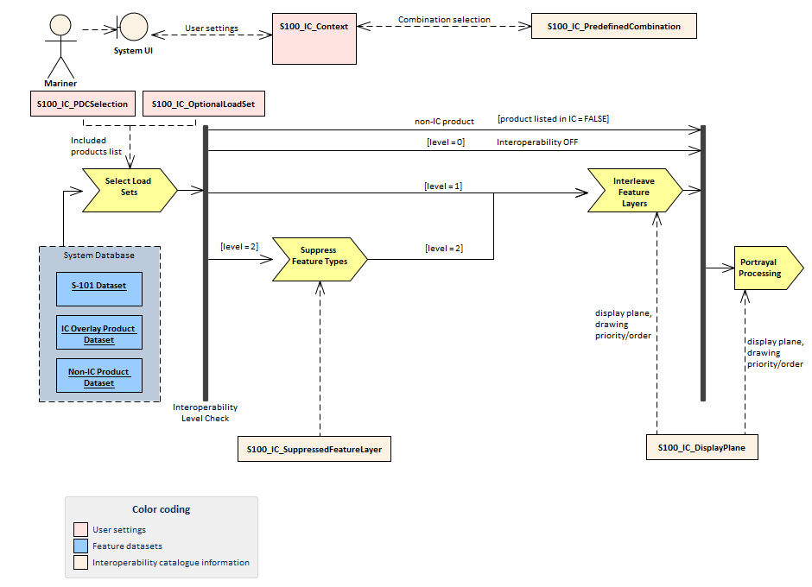
Hypothetical processing model
Option with portrayal processing before interoperability processing will also be allowed

Slide 14
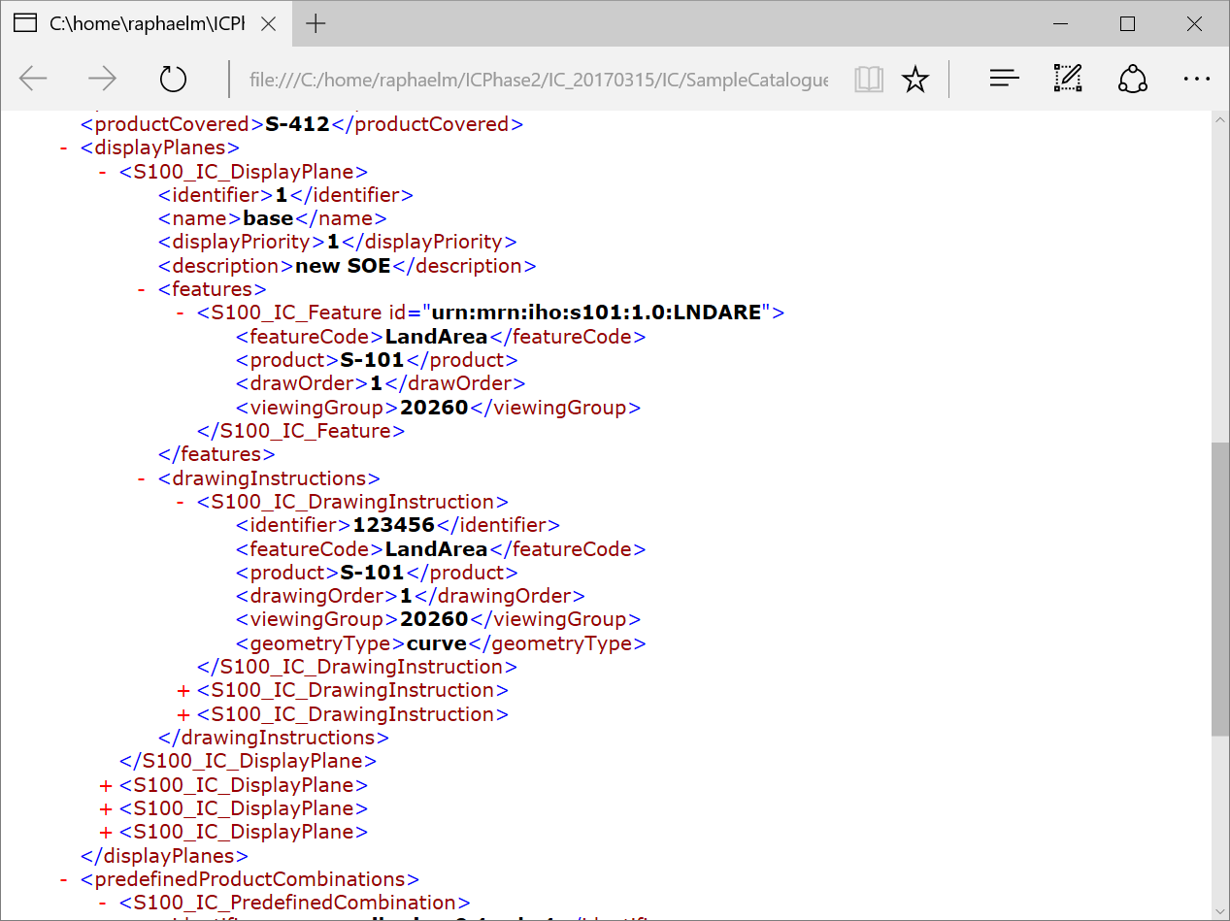
Catalogue will be in XML

